Slide 1
Section 1.1
Tables and Graphs of Linear Equations

Slide 2
Objectives:
Students will be able to represent a real-world linear relationship in a table, graph, or equation.
Students will be able to identify linear equations and linear relationships between variables in a table.

Slide 3
When a constant difference in consecutive x-values results in a constant difference in consecutive y-values, the variables are linear related.
Example 1: Are the variables linear related?
What is the y-value that corresponds to an x-value of 20?
41
x | 2 | 5 | 8 | 11 | 14 | 17
y | 5 | 11 | 17 | 23 | 29 | 35

Slide 4
Example 2:
Are the variables in y = x³ linearly related?
x | 1 | 2 | 3 | 4
y

Slide 5
Writing Equations
An equation representing a linear relationship is a linear equation.
Its graph is a line.

Slide 6
Writing Equations
Example 3: Catch-a-Call answering service charges $19.00 per month and $0.10 per minute for each call.
Make a table of values for the total charges for 1, 2, 3, 4, and 5 min.
Write an equation to represent the total monthly cost.

Slide 7
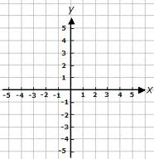
Graphs of Linear Equations
Example 4: Sketch the graph of y = 2x – 1 using a table of values.
x | y
1
2
3
4

Slide 8
Using Graphing Calculators
Example 5: A 200-gallon tank is half full when Darla begins to fill it. The water fills up at a rate of 10 gallons per minute.
Write an equation to find the volume, v, in gallons of water over time, t, in minutes.
Graph the equation on your graphing calculator.
Find the volume after 8 minutes algebraically AND graphically.

Slide 9
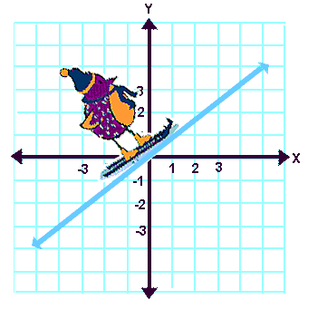
A graph that slopes upward from left to right is INCREASING
Notes:
9

Slide 10
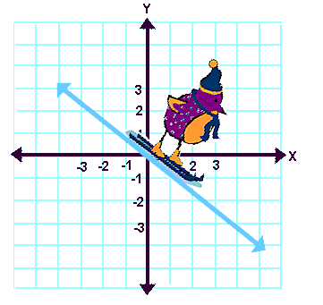
A graph that slopes downward from left to right is DECREASING
Types of Slopes
Notes:
10

Slide 11
Classwork: Graphing Calculator Extension
Graph the following. Are they linear or nonlinear?
3x – 5 = y
y = 3
y = $\frac{1}{x}$
y = (2x + 1)(2x – 1)

Slide 12
Homework:
Practice and Apply Worksheet 1.1

