Slide 1
Section 1.2
Slopes and Intercepts

Slide 2
Objective:
Students will be able to write an equation in slope-intercept form, given two points on the line or the slope and a point on the line.

Slide 3
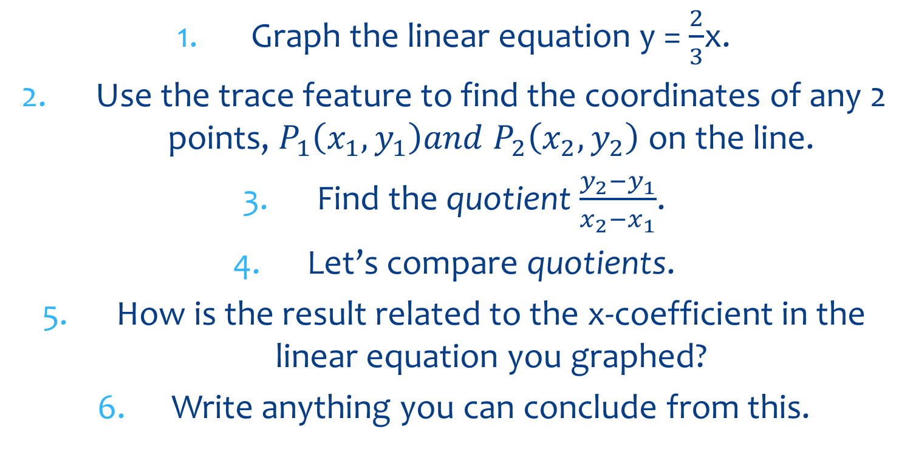
Graphing Calculator Exploration
Graph the linear equation y = $\frac{2}{3}$x.
Use the trace feature to find the coordinates of any 2 points, $P_{1}\left(x_{1},y_{1}\right)and P_{2}\left(x_{2},y_{2}\right)$on the line.
Find the quotient $\frac{y_{2}−y_{1}}{x_{2}−x_{1}}$.
Let’s compare quotients.
How is the result related to the x-coefficient in the linear equation you graphed?
Write anything you can conclude from this.

Slide 4
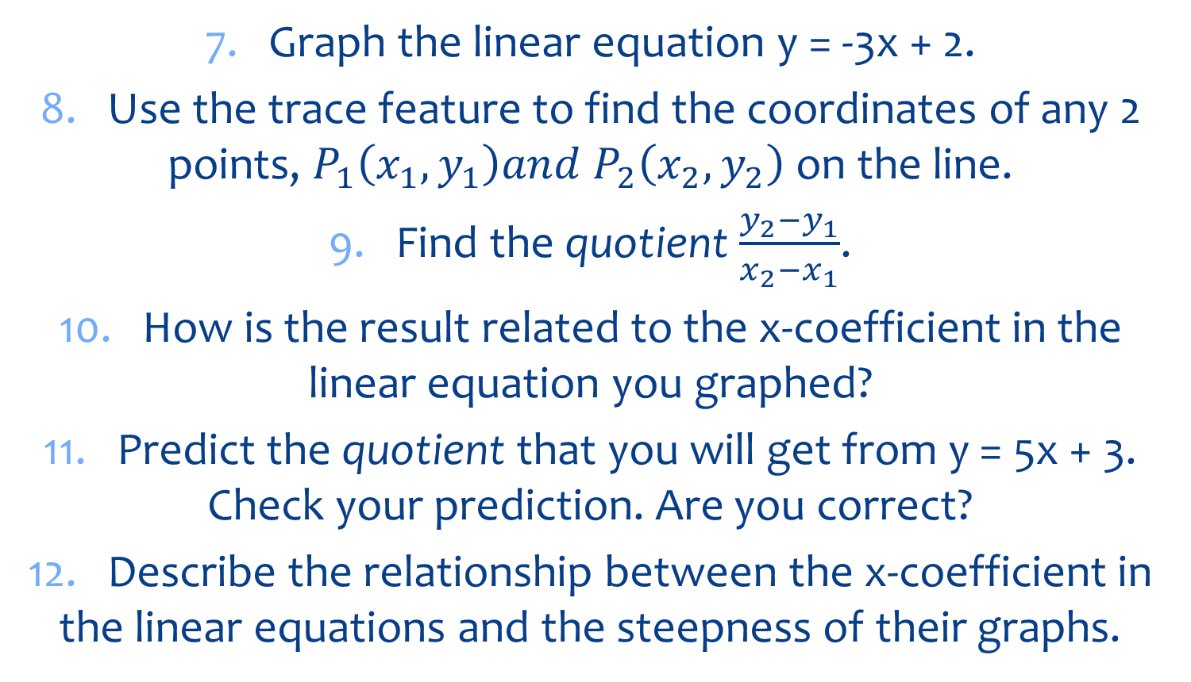
Continued: Graphing Calculator Exploration
7. Graph the linear equation y = -3x + 2.
8. Use the trace feature to find the coordinates of any 2 points, $P_{1}\left(x_{1},y_{1}\right)and P_{2}\left(x_{2},y_{2}\right)$on the line.
9. Find the quotient $\frac{y_{2}−y_{1}}{x_{2}−x_{1}}$.
10. How is the result related to the x-coefficient in the linear equation you graphed?
11. Predict the quotient that you will get from y = 5x + 3. Check your prediction. Are you correct?
12. Describe the relationship between the x-coefficient in the linear equations and the steepness of their graphs.

Slide 5
Slope
The slope (gradient, incline, pitch) is used to describe the steepness of a straight line.
The slope is also known as the rate of change.
Notes:
5

Slide 6
Rate of Change of a Linear Relationship
run
rise
Rate of Change =

Slide 7
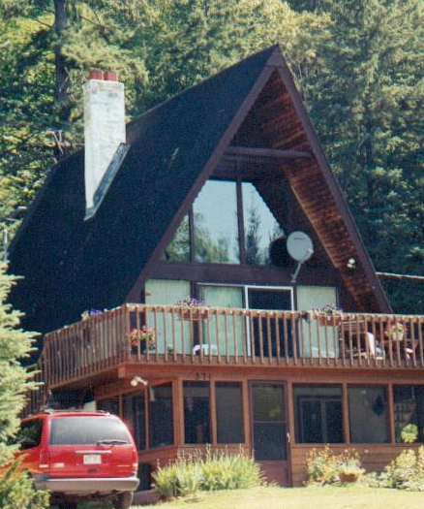
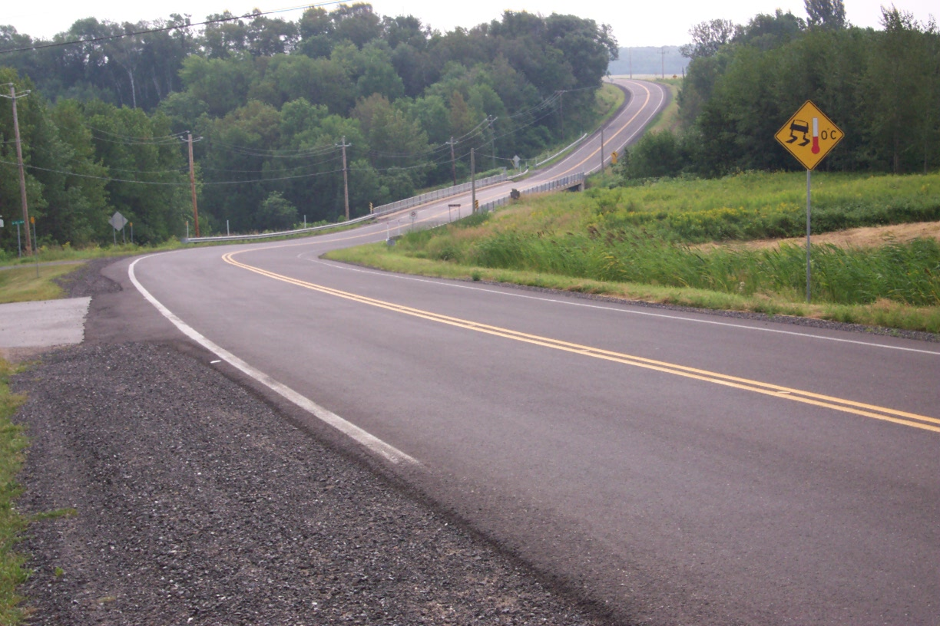
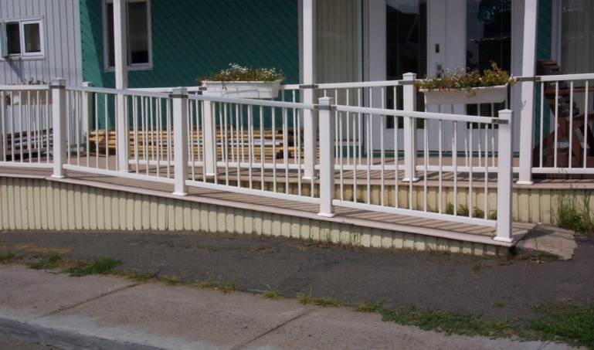
Rates of change are seen everywhere.

Slide 8
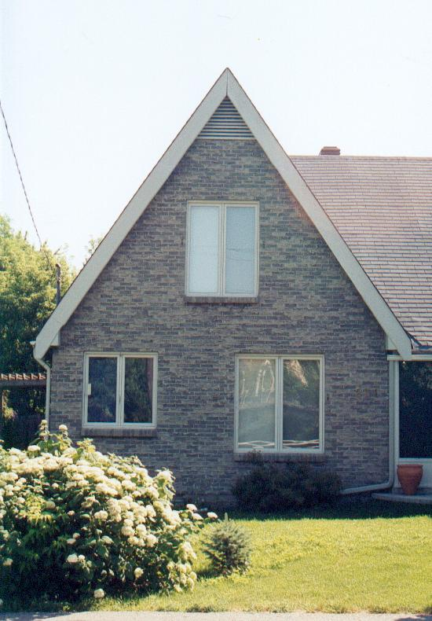
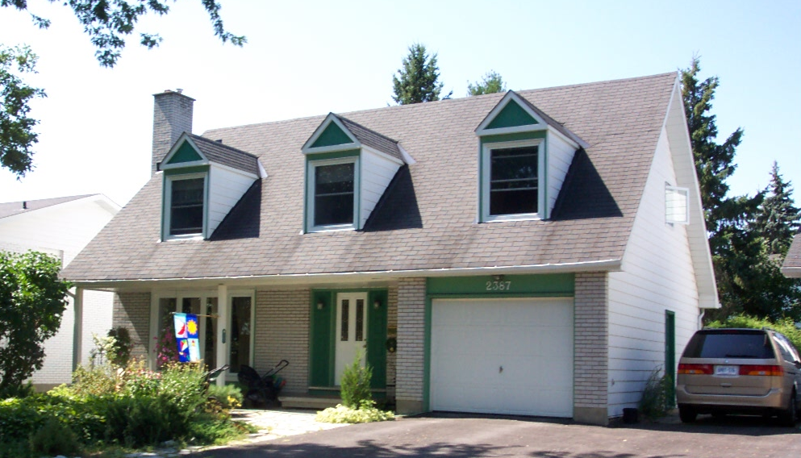
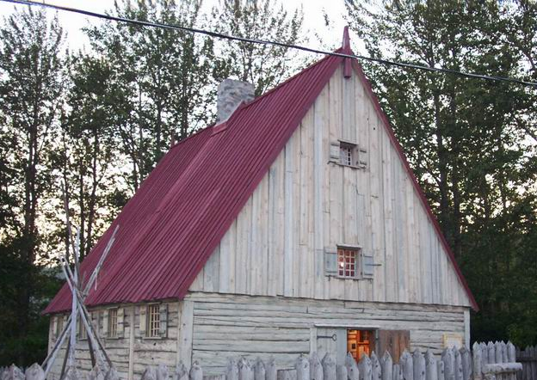
The steepness of the roof of a house.

Slide 9
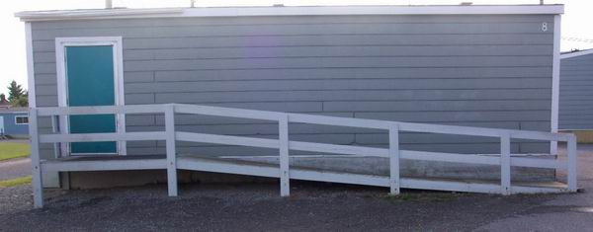
The steepness of wheelchair ramps is of great importance for safety.
1
12
Average rate of change of any wheelchair ramp =
If the rise is 1.5 m, what is the run?
Answer: 18 m because

Slide 10
Determine the average rate of change of the roof.
3 m
5 m

Slide 11
Determine the average rate of change of each staircase.
3
2
3
3

Slide 12
Slope is a ratio and can be expressed as:
Vertical Change or Rise or Change in y Horizontal Change Run Change in x
Slope formula:
Notes:
12

Slide 13
Slope Formula:
Note: The order of subtraction is important.
You must form the numerator and denominator using the same order of subtraction.
Incorrect:
m = y2 –y1
x1 – x2

Slide 14
Calculate the slope between (-3, 6) and (5, 2)

Slide 15
The Graph: Find the slope between (-3, 6) and (5, 2)
y-axis
(-3, 6)
(5, 2)
x-axis
Rise
-4
-1
=
=
Run
8
2

Slide 16
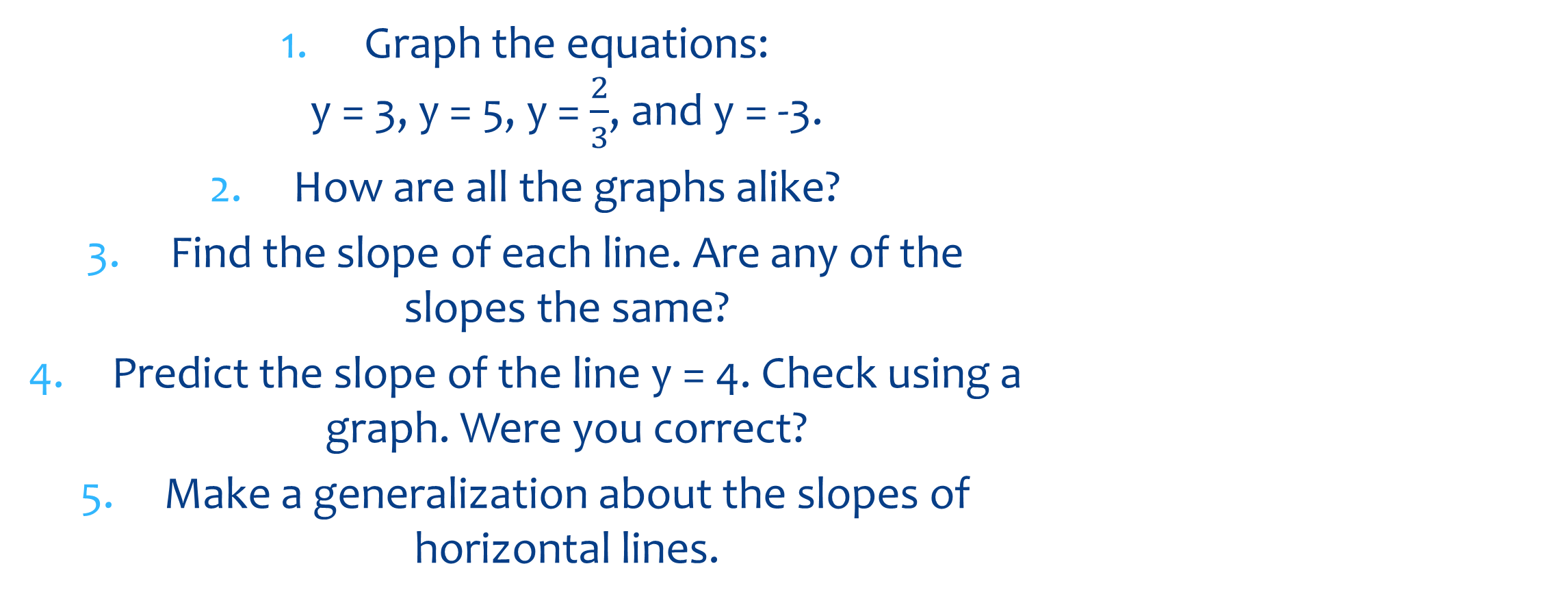
Graphing Calculator Exploration
Graph the equations: y = 3, y = 5, y = $\frac{2}{3}$, and y = -3.
How are all the graphs alike?
Find the slope of each line. Are any of the slopes the same?
Predict the slope of the line y = 4. Check using a graph. Were you correct?
Make a generalization about the slopes of horizontal lines.

Slide 17
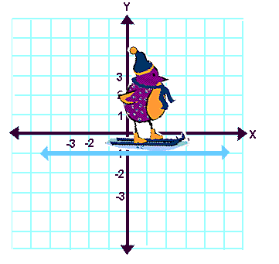
Types of Slopes
Horizontal lines have zero slope:
m = 0
Notes:
17

Slide 18
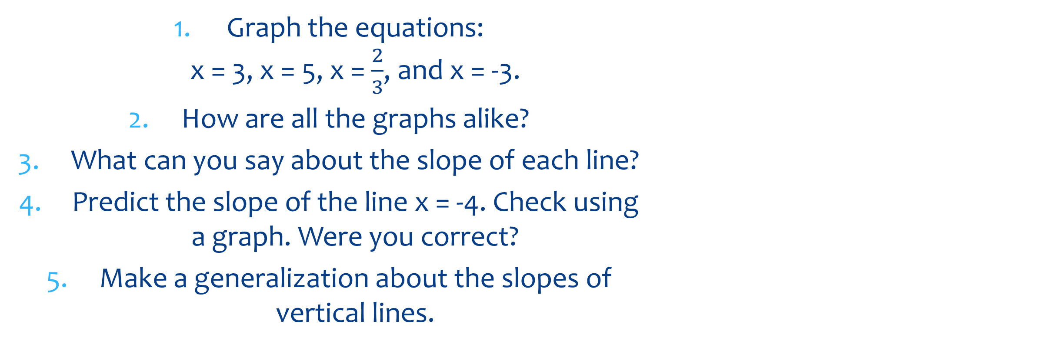
Graphing on Paper Exploration
Graph the equations: x = 3, x = 5, x = $\frac{2}{3}$, and x = -3.
How are all the graphs alike?
What can you say about the slope of each line?
Predict the slope of the line x = -4. Check using a graph. Were you correct?
Make a generalization about the slopes of vertical lines.

Slide 19
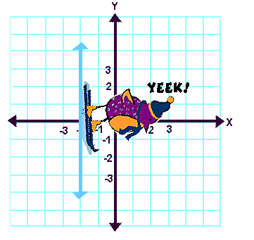
Types of Slopes
Vertical lines have no slope or an undefined slope.
Notes:
19

Slide 20
Slope – Intercept Form
y = mx + b
y – intercept (where the line crosses the y-axis)
y - coordinate
x - coordinate
Slope
Example: Write the linear equation with a slope of 3 and a y-intercept of 4.
y = 3x + 4

Slide 21
Just by looking at an equation in this form, we can draw the line (no tables).
y-intercept = 1.
slope = 2.
y-intercept = -4.
slope = -1.
y-intercept = -2.
slope = 3/2.

Slide 22
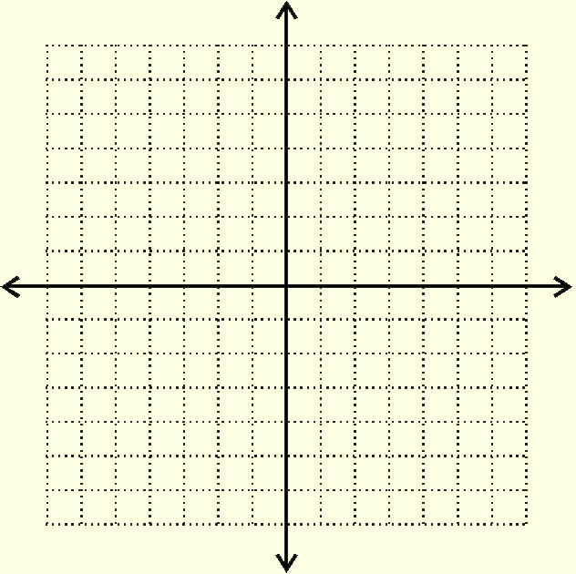
Graph
right 1
1) Plot the y-intercept
right 1
up 2
up 2
2) Plot more points by counting the slope up the numerator (down if negative) and right the denominator

Slide 23
Lines Used for Estimation
The cash flow per share for Verizon was $2.38 in 1998 and $2.80 in 1999.
Write a linear equation that gives the cash flow per share in terms of the year.

Slide 24
Solution:
The cash flow per share for Verizon was $2.38 in 1998 and $2.80 in 1999.
Let x = 0 represent 1998.
Then the two given values are represented by the points:
(0, 2.38) and (1, 2.80)
The slope of the line passing through these points is:
m = 2.80 – 2.38 = 0.42
1 – 0

Slide 25
Solution:
We have two points (0, 2.38) and (1, 2.80)
and the slope 0.42
Find the y-intercept:
y = mx + b
2.38 = 0.42 (0) + b
2.38 = b
Final Equation: y = 0.42x + 2.38

Slide 26
Making Predictions:
y = 0.42x + 2.38
Predict the cash flow in 2002.
Since year x = 0 corresponds to 1998,
2002 → x = 4
y = 0.42 (4) + 2.38
y = 4.06
The cash flow is $4.06 in 2002

Slide 27
Verizon Cash Flow
5
4
y
3
2
1
y
Here is the graph corresponding to our linear equation and predicted cash flow.
(4, 4.06)
Cash flow per share (in $)
(1, 2.80)
(0, 2.38)
x
1 2 3 4 5
Year (0 → 1998)

Slide 28
Collin’s Writing (Write for 5 minutes)
Suppose (-1, 7), (0, 4), and (2, -2) are all points on one line.
Is the slope of the line the same no matter which two points you use to find the slope?
Why or why not?

Slide 29
Classwork/Homework:
Practice and Apply Worksheet 1.2

Slide 30
Collin’s Writing (Write for 5 minutes)
What do you think 0 divided by 0 would equal?
Write WHY you wrote what you did.

