Slide 1
Section 1.4
Direct Variation and Proportion

Slide 2
Objectives:
Solve problems involving direct variation.

Slide 3
Do Now (5 minutes):
Write down examples of real world data that increase or decrease at a constant rate.
Examples to get you started:
The cost of an item and the percent tax.
You multiply the cost by the constant tax rate.

Slide 4
More Examples:
The more gas you pump, the more money you pay.
The more time I drive (at a constant rate), the more miles I go.
If I increase a recipe for more people, the more of an ingredient I need.
The more hours I work, the more money I make.
The more CD’s I purchase, the more money it costs.
The less cheese I buy at the deli, the less money I pay.

Slide 5
Another Example:
The relationship between the number of seconds it takes to hear the thunder after a lightning strike and the distance you are from the lightning.
Distance in miles (x) | 0 | 1 | 2 | 3 | 4 | 5
Seconds (y) | 0 | 5 | 10 | 15 | 20 | 25

Slide 6
Direct Variation
In a direct variation, one variable is a constant multiple of the other.
y varies directly as x.
y = kx, where k is the constant of variation and k ≠ 0.

Slide 7
Example 1:
The distance, d, traveled at a constant rate, k, varies directly with the time, t, in hours.
Suppose it takes 2.5 hours to travel 75 miles at a constant rate.
Find this constant and write the direct variation equation.
d = kt
75 = k (2.5)
30 = k
Equation→ d = 30t

Slide 8
Example 2:
Suppose y varies directly as x.
y = -42 when x = 6.
a) Find the constant of variation, k.
b) Find the direct variation equation.
y = kx
-42 = k (6)
-7 = k
Equation→ y = -7x

Slide 9
Proportions:
Any two ordered pairs that satisfy a direct variation are proportional.
Example: y = 6x
These points satisfy the equation (1, 6) and (4, 24)
$$\frac{6}{1}=\frac{24}{4}$$
***Use cross multiplication when solving proportions.***

Slide 10
Example 3:
Wages for workers at Market Basket are paid by the hour.
Sally worked 18 hours and earned $114.30.
How many hours must Sally work to earn $127.00?
$\frac{Hours}{Pay}$ → $\frac{18}{114.30}$ =$\frac{x}{127.00}$
18 (127.00) = 114.30(x)
2286 = 114.3x
20 = x
She must work 20 hours.

Slide 11
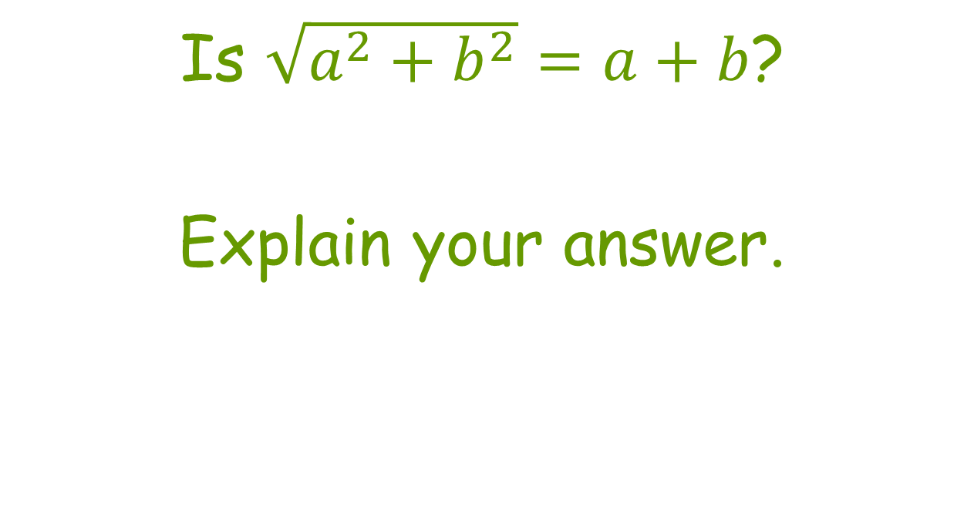
Collin’s Writing (3 minutes)

Slide 12
Classwork/Homework:
Classwork: Practice and Apply Worksheet 1.4
Homework: Pg 33, Ex: 2-18 (mult 2), 26-34 (mult 2)

