Slide 1
Section 1.5
Solving Equations

Slide 2
Objectives:
Solve problems by writing and solving linear equations.

Slide 3
Solving Equations by Graphing:
Do Now:
Example 1: Solve by graphing.
-2 = 3x + 4
2x – 1 = 4x – 5

Slide 4
Summary of the Steps Used to Solve Equations by Graphing
Step 1: Graph the two equations, one representing the left side and one representing the right side.
Step 2: Find the point of intersection.
2nd → CALC→ 5:intersect
Go to the first line near the point of intersection and press ENTER.
Go to the second line near the point of intersection and press ENTER.
Then press ENTER again.
Step 3: If we are solving for x, use the first value in the point of intersection. That is your answer!

Slide 5
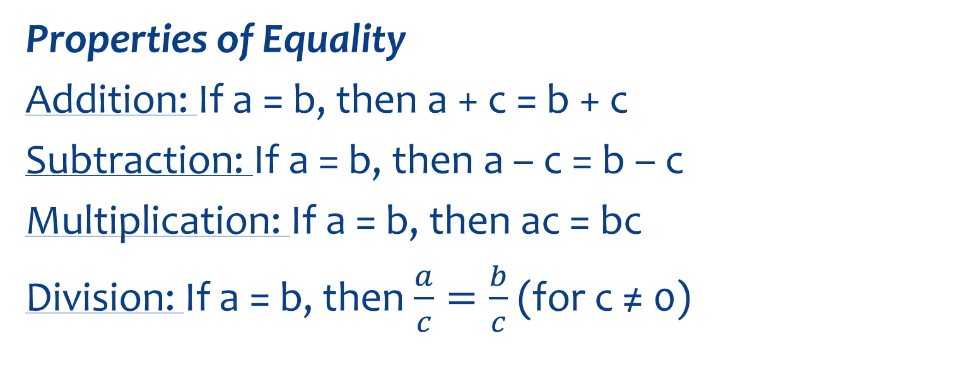
Equations can also be solved algebraically!
Properties of Equality
Addition: If a = b, then a + c = b + c
Subtraction: If a = b, then a – c = b – c
Multiplication: If a = b, then ac = bc
Division: If a = b, then $\frac{a}{c}=\frac{b}{c}$ (for c ≠ 0)

Slide 6
Example 2:
The equation relating Celsius and Fahrenheit temperatures is F = $\frac{9}{5}$C + 32.
Find the degrees Celsius equal to 122°F.
Solve graphically AND algebraically.
Solve 122 = $\frac{9}{5}$C + 32
Graphically: Use the calculator.
Graph $y_{1}=122$ and $y_{2}=\frac{9}{5}c+32.$
Find the point of intersection.
(50, 122)
The solution is 50 °C

Slide 7
Example 2:
Solve 122 = $\frac{9}{5}$C + 32
Algebraically:
Subtract 32 from both sides.
122 – 32 = $\frac{9}{5}$C + 32 – 32
90 = $\frac{9}{5}$C
Multiply both sides by $\frac{5}{9}.$
$\left(\frac{5}{9}\right)$90 = $\left(\frac{5}{9}\right)$ $\frac{9}{5}$C
50 = C
The solution is 50 °C

Slide 8
The Distributive Property
For any real numbers a, b, and c,
a(b + c) = ab + ac
and
(b + c)a = ba + ca.

Slide 9
Equivalent
Equivalent = same value
Equivalent Equations have the same solutions.
Substitution Property – If two equations are equivalent, you can replace one with the other.
Examples of Equivalent Equations:
3x = 12 and x = 4
x – 5 = 0 and x = 5

Slide 10
Example 3:
Given that y = 4 – 2x, solve 3x + 5y = 6 for x and y.
3x + 5(4 – 2x) = 6
3x + 20 – 10x = 6
-7x + 20 = 6
-7x = -14
x = 2
y = 4 – 2(2)
y = 0
Solution→ x = 2 and y = 0

Slide 11
Example 4:
Given that x = 3y – 1, solve 5x – 2y = 21 for x and y.
5(3y – 1) – 2y = 21
15y – 5 – 2y = 21
13y – 5 = 21
13y = 26
y = 2
x = 3(2) – 1
x = 5
Solution→ x = 5 and y = 2

Slide 12
Example 5:
Given the equation V = $\frac{1}{3}b^{2}h$, solve for h in terms of V and b.
Multiply both sides by 3
3V = $b^{2}h$
Divide both sides by $b^{2}.$
$$\frac{3v}{b^{2}}=h$$
$$h=\frac{3v}{b^{2}}$$

Slide 13
Classwork/Homework:
Classwork: Practice and Apply Worksheet 1.5
Homework: Pg 42-43 Ex: 3-45 (mult of 3)

