Slide 1
Section 1.6
Solving Inequalities

Slide 2
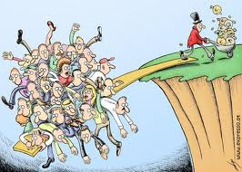
Objectives:
Solve and graph linear inequalities.

Slide 3
Inequalities
An inequality is a mathematical sentence that contains <, >, ≤, ≥, or ≠.

Slide 4
Example 1: Write an inequality for each.
To qualify for the police force, a candidate must be at least 66 in. and not more than 78 in. tall.
To make the honor roll, you must have a GPA equal to or higher than 3.0.
Children under 12 pay half price.

Slide 5
Addition and Subtraction Properties of Inequality.
Addition:
If a < b, then a + c < b + c.
If a > b, then a + c > b + c.
Subtraction:
If a < b, then a – c < b – c.
If a > b, then a – c > b – c.
The same is true for ≤ and ≥.

Slide 6
Multiplication and Division Properties of Inequality
Let c be a positive number and d be a negative number.
Multiplication:
If a < b, then ac < bc and ad > bd.
If a > b, then ac > bc and ad < bd.
Division:
If a < b, then $\frac{a}{c}<\frac{b}{c}$ and $\frac{a}{d}>\frac{b}{d}.$
If a > b, then $\frac{a}{c}>\frac{b}{c}$ and $\frac{a}{d}<\frac{b}{d}.$
The same is true for ≤ and ≥.

Slide 7
Last Slide in Words:
IMPORTANT:
Whenever you multiply or divide by a negative number, you MUST reverse the inequality symbol.

Slide 8
Example 2:
T-Mobile charges $35.00 and $0.35 per minute for long distance calls each month.
The length of the call is rounded up to the closest minute.
Verizon charges $75.00 per month with no long distance charges.
For how many minutes will it cost less to use T-Mobile?
Write inequality.
T-Mobile costs < Verizon costs
$35 + $0.35x < $75
Solve the inequality.
$0.35x < $40
x < 114.29
Therefore, it will be cheaper when you talk less than 115 min.

Slide 9
Example 3:
Solve the inequality.
-2s + 4 < 3s – 11
-5s < -15
s > 3

Slide 10
Example 4: Graphing Inequalities in One Variable.
a) Graph x < 4
o
o
2
2
3
3
4
4
b) Graph x ≥ 2
●
●
2
3
4

Slide 11
Example 5:
Solve and graph the inequality.
3t – 1 ≥ -2t + 9
5t – 1 ≥ 9
5t ≥ 10
t ≥ 2
●
2
3
4

Slide 12
Linear Inequalities
A linear inequality is an inequality which involves a linear function.
An ordered pair (x, y) is a solution if it is TRUE when x and y are substituted into the inequality.

Slide 13
Example 6:
Which ordered pair is a solution of
5x - 2y ≤ 6?
(0, -3)
(5, 5)
(1, -2)
(3, 3)
Notes:
ANSWER: A. (0, -3)

Slide 14
Homework:
Pg 52
Exercises 7, 8, 12, 15 – 21, 31

Slide 15
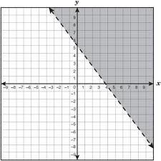
Graphing a Linear Inequality
Graphing a linear inequality is very similar to graphing a linear equation.

Slide 16
Graphing a Linear Inequality
1) Solve the inequality for y (or x if there is no y).
2) Change the inequality to an equation and graph.
3) If the inequality is < or >, the line is dotted. If the
inequality is ≤ or ≥, the line is solid.
4) Shade the correct area using a test point.

Slide 17
Example 7:
Graph the inequality 3 - x > 0
First, solve the inequality for x.
3 - x > 0
-x > -3
x < 3

Slide 18
Graph: x<3
6
Step 1: Graph the line
x = 3.
Step 2: Because x < 3
the line will be dotted.
Step 3: Use a test point to
shade the correct side.
4
2
3

Slide 19
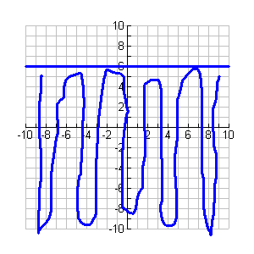
On your Own: Graph: y < 6

Slide 20
Example 8: Sketch a graph of x + y < 3
Step 1: Solve the equation for y
y < -x + 3
Step 2: Graph the line y = -x + 3 using a dashed line.
Step 3: Use a test point not on the line to determine shading.
(0,0) → True so shade that side.

Slide 21
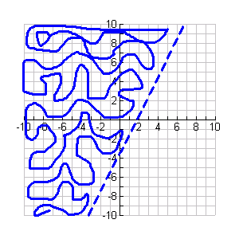
On your own: Graph 4x – 2y < 7

Slide 22
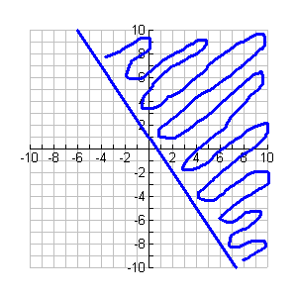
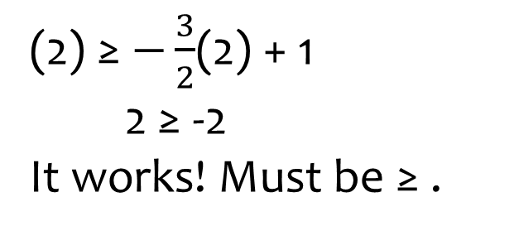
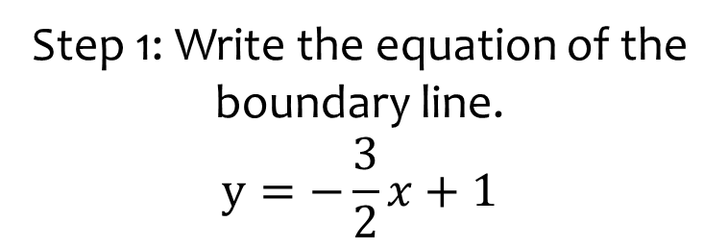
Example 9: Write the inequality represented by the graph.
Step 1: Write the equation of the boundary line.
$$y=−\frac{3}{2}x+1$$
Step 2: The line is solid (≥ or ≤).
Test to see which one works.
Step 3: Test a point in the shaded area. → (2, 2)
Let’s try ≥ first.
$$y≥−\frac{3}{2}x+1$$
(2) ≥ $−\frac{3}{2}$(2) + 1
2 ≥ -2
It works! Must be ≥ .
$$y≥−\frac{3}{2}x+1$$

Slide 23
Example 10:
Sue wants to buy CDs and DVDs.
She has $28 to spend.
The CDs cost $7 each and the DVDs cost $14 each.
What are the possible combinations of CDs and DVDs she can buy?
Solution: Write the inequality and graph it. All whole number coordinate pairs in the shaded region represent the combinations she can buy.

Slide 24
Example 10 Continued:
Find Inequality.
x = CDs and y = DVDs
Total Cost ≤ $28
7x + 14y ≤ 28
Graph it!
14y≤ -7x + 28
y ≤ - ½x + 2

Slide 25
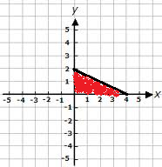
Example 10 Continued:
y ≤ - ½x + 2
Possible Combinations:
0 CDs, 0 DVDs
0 CDs, 1 DVDs
0 CDs, 2 DVDs
1 CDs, 0 DVDs
1 CDs, 1 DVDs
1 CDs, 2 DVDs
2 CDs, 0 DVDs
2 CDs, 1 DVDs
4 CDs, 0 DVDs
7x + 14y ≤ 28

Slide 26
Homework:
Practice and Apply Worksheet 1.6
Chapter 1 Test on Tuesday

