Slide 1
“Do Now” (3 minutes):
Many things in the world are related:
Write down as many things in the world that relate two quantities by some rule…

Slide 2
Section 2.3
Definition of a function

Slide 3
Objectives:
Identify and compare relations and functions.
Use the vertical line test to identify functions.
Use functions to model real-world applications, and give appropriate domain and range restrictions for the situation.

Slide 4

First, let’s talk about relations
Notes:
Define the relationships that are presented.
Husband and Wife
Father and son
Foot length shoe size
Number of drinks and BAC

Slide 5
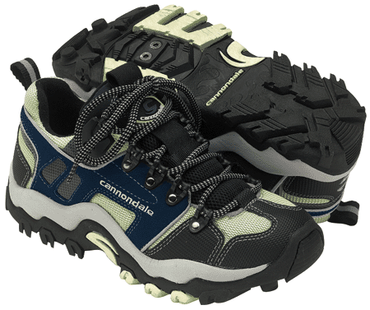
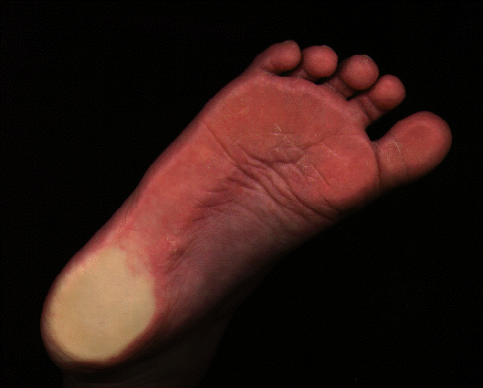
Relations
Notes:
Define the relationships that are presented.
Husband and Wife
Father and son
Foot length shoe size
Number of drinks and BAC

Slide 6
Relations
(A)
(B)
(C)
32 mpg
8 mpg
16 mpg
Notes:
Match the miles per gallon to the vehicle
Write the definition of RELATION:
“The way one thing is related to another, to reference to or connection with”
“A set of ordered pairs”
What is meant by “Ordered pairs”
Which is causing which?
The miles per gallon causes the vehicle size
The vehicle size causes the miles per gallon
The “independent” variable causes the “dependent” variable (in most cases)

Slide 7
Back to our “Do Now”:
Many things are related:
Write down as many things in the world that relate two quantities by some rule…

Slide 8
Area of a Circle relates to its Radius
A = πr²

Slide 9

The distance d traveled on a bike in 2 hours is related to the speed s
d = 2s

Slide 10

However, not all relations have simple math formulas…
Example:
Hours of the day with temperature...
Can you think of a simple equation???

Slide 11
Relations:
A Relation is a set of ordered pairs.
The set of the first coordinates is called the domain.
The set of the second coordinates is called the range.

Slide 12
Domain
Range
Correspondence
or
Relation

Slide 13
Relations
x | y
-4 | 5
-2 | 6
0 | 2
Example:
Domain: {-4, -2, 0}
Range: {5, 6, 2}

Slide 14
Example:
Given the relation
{(-4, 3), (-1, -2), (0, -4), (2, 3), (3, -3)}
What is the domain?
{-4, -1, 0, 2, 3}
What is the range?
{3, -2, -4, -3},
(note it is not required list a number twice)

Slide 15
Functions
A function is a relation in which each element of the domain is paired with exactly one element of the range.
There is one and only one output (y) with each input (x).
f(x)
y
x

Slide 16
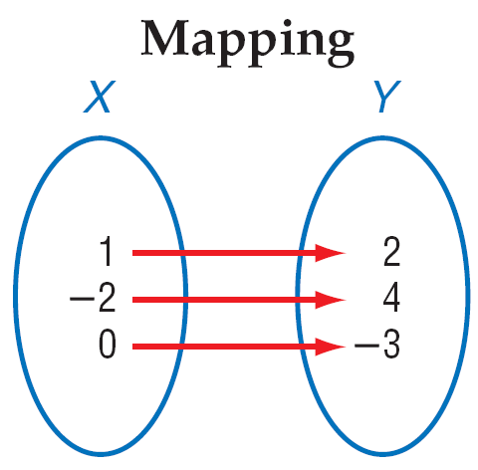
Mapping
In a function, each x goes to ONLY ONE y.

Slide 17
If we think of the domain as the set of boys and the range the set of girls, then a function is a monogamous relationship from the domain to the range.
Each boy gets to go out with one and only one girl.
But, with functions, it does not say anything about the girls…
They can have as many boyfriends as they want.
Notes:
Make up an example of a function

Slide 18
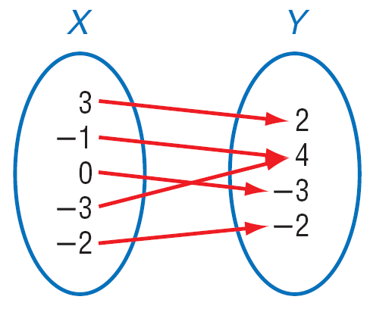
Another example of a function:
Given the mapping:
What is the domain?
{3, -1, 0, -3, -2}
What is the range?
{2, 4, -3, -2}

Slide 19
Types of Functions
1. One-to-One
Each element of the range is paired with exactly one element of the domain

Slide 20
2. Not One-to-One Function

Slide 21
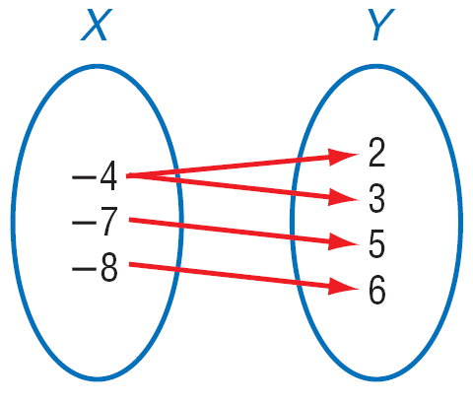
3. Not a Function
The domain value is paired with more than one range value

Slide 22
Mathematical Examples
Decide if the following relations are functions.
X Y
1 2
-5 7
-1 2
3 3
X Y
1 1
-5 1
-1 1
3 1
X Y
1 2
1 7
1 2
1 3
X Y
1 π
π 1
-1 5
π 3

Slide 23
Is this relation a function?
{(1,3), (2,3), (3,3)}
Yes
No

Slide 24
Exit ticket:
Decide if the Relation is a Function
The relation is the year and the cost of a first class stamp.
The relation is the weight of an animal and the beats per minute of it’s heart.
The relation is the time of the day and the intensity of the sun light.
The relation is a number and it’s square.
The relation is the time since you left your house for work and your distance from home.
Notes:
This is one place the real world and math don’t mix very well. In most cases the real world works in the set of rational numbers. In fact, we round off most irrationals to rational to be able to work with them. Yet in mathematics, the definition of your domain and range in a sense defines the relation. For two relations to be equivalent they must have the same set of ordered pairs. That is each element in the domain must be matched with the exact same element in the range. For example, the square root of x squared is equivalent to the absolute value of x.

Slide 25
Homework:
Pg # 80 – 81 Exercises: 1, 3, 7 – 10 , 15 – 18

Slide 26
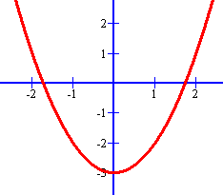
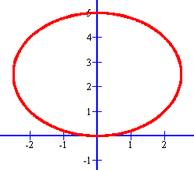
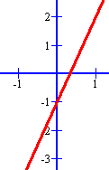
Vertical Line Test (pencil test)
If any vertical line passes through more than one point of the graph, then that relation is not a function.
Are these functions?
FUNCTION!
FUNCTION!
NOPE!

Slide 27
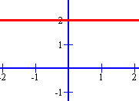
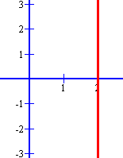
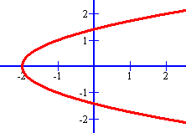
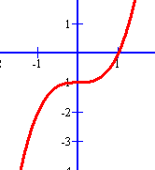
Vertical Line Test
FUNCTION!
NO!
NO WAY!
FUNCTION!

Slide 28
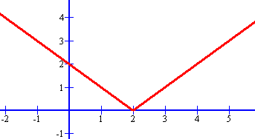
Is this a graph of a function?
Yes
No

Slide 29
Determining the domain and range from the graph of a relation:
y
Find the domain and range of the function.
Use interval notation.
Domain
x
Range
Domain is [-3, 4]
Range is [-4, 2]

Slide 30
Example
y
Find the domain and range.
Range
x
Domain is (-∞, ∞)
Range is [-2, ∞)
Domain

Slide 31
Example
Find the domain and range.
y
x
Domain: (-∞, ∞)
Range: (-∞, ∞)

Slide 32
Example
Find the domain and range.
y
x
Domain: (-∞, ∞)
Range: [-2.5]
(The range is one single y-value.)

Slide 33
Example
Find the domain and range.
(Note: this relation is NOT a function, but it still has a domain and range.)
y
x
Domain: [-4, 4]
Range: [-4.3, 0]

Slide 34
Example
Find the domain and range.
(Note: this relation is NOT a function, but it still has a domain and range.)
y
x
Domain: [2]
Range: (-∞, ∞)

Slide 35
Find the domain and range of the function.
5
4
3
2
1
-5
-4
-3
-2
-1
1
2
3
4
5
-1
-2
-3
-4
-5

Slide 36
Solution
The open dot on the left shows that x = -3 is not in the domain.
The closed dot on the right shows that x = 6 is.
The
domain
is (-3, 6].
5
4
3
2
1
-5
-4
-3
-2
-1
1
2
3
4
5
-1
-2
-3
-4
-5

Slide 37
Solution
The points on the graph all have y-coordinates between -4 (not including) and 4 (including).
The range
is (-4, 4].
5
4
3
2
1
-5
-4
-3
-2
-1
1
2
3
4
5
-1
-2
-3
-4
-5

Slide 38
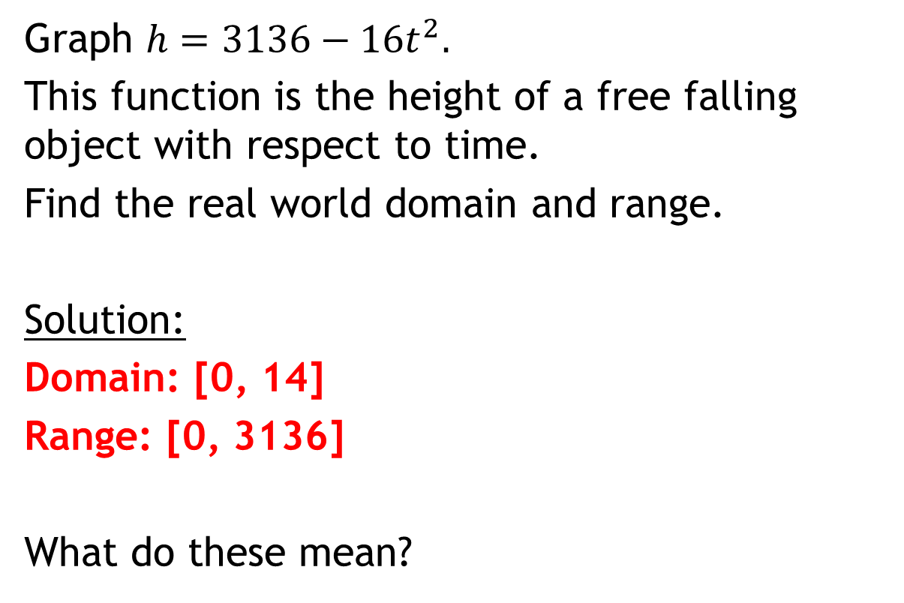
Example Using the graphing calculator!
Graph $h=3136−16t^{2}.$
This function is the height of a free falling object with respect to time.
Find the real world domain and range.
Solution:
Domain: [0, 14]
Range: [0, 3136]
What do these mean?

Slide 39
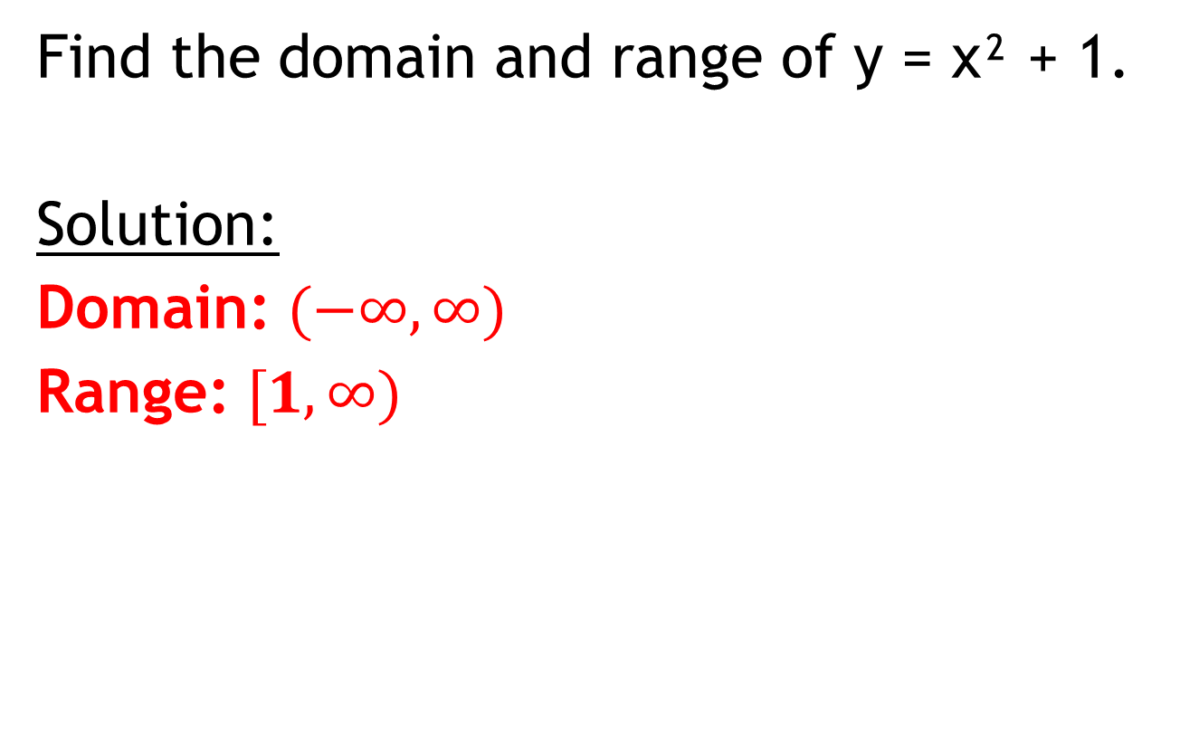
Example Using the graphing calculator!
Find the domain and range of y = x² + 1.
Solution:
Domain: $(−∞, ∞)$
Range: $[1, ∞)$

Slide 40
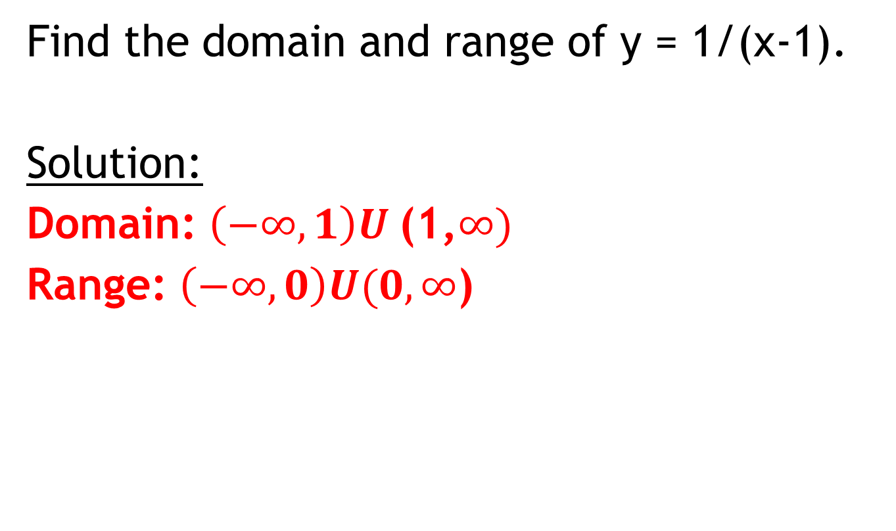
Example Using the graphing calculator!
Find the domain and range of y = 1/(x-1).
Solution:
Domain: $\left(−∞, 1\right)U$(1,$∞)$
Range: $\left(−∞, 0\right)U(0,∞$)

Slide 41
Exit Ticket (5 minutes):
Write down the difference between the domain and range of a function and the REAL WORLD domain or range of that function.

Slide 42
Homework:
Practice and Apply Worksheet 2.3
2.1-2.3 Test on Tuesday

Slide 43
Classwork:
Matching activity
Review for the 2.1-2.3 Test

