Slide 1
Section 6.2
The Factored Form of a Polynomial

Slide 2
Objectives:
Write the factored form of a polynomial.
Define and use the Factor Theorem of Algebra to find the zeros of polynomial functions.

Slide 3
Example 1:
Jen throws a pebble from a 240-foot high bridge.
The initial velocity is 32 feet per second.
Write the quadratic function that models the height as the time changes:
$h\left(t\right)= {−\frac{1}{2}gt^{2}+v}_{0}t+h_{0}$
$h\left(t\right)= {−\frac{1}{2}32t^{2}+32t+240}_{}$
$h\left(t\right)=−16t^{2}+32t+240$
What is the leading coefficient?
What is the degree?
This can also be written in factored form as:
$$h\left(t\right)=−16\left(t−r_{1}\right)\left(t−r_{2}\right)$$
We need to find the zeros to find $r_{1}$ and$r_{2}$
-16
2

Slide 4
Example 1:
$h\left(t\right)=−16t^{2}+32t+240$
$h\left(t\right)=−16\left(t−r_{1}\right)\left(t−r_{2}\right)$
We need to find the zeros to find $r_{1}$ and$r_{2}$.
Using your graphing calculator, find the zeros.
Zeros: -3 and 5
$h\left(t\right)=−16\left(t−−3\right)\left(t−5\right)$
$h\left(t\right)=−16\left(t+3\right)\left(t−5\right)$
Check answer by re-distributing.
When will the pebble hit the water?
5 seconds.
What is the real world domain of h?
[0, 5]

Slide 5
Review of Special Products:
Difference of Squares: a² – b² = (a – b)(a + b)
Examples:
a) Factor f(x) = x² – 9. What are the zeros?
f(x) =(x – 3)(x + 3)
Zeros: 3 and -3
b) Factor f(x) = x⁴ – 16. What are the zeros?
f(x) =(x² – 4)(x² + 4)
f(x) = (x – 2)(x + 2)(x² + 4)
Real Zeros: 2 and -2
Imaginary Zeros: ±2i

Slide 6
Review of Special Products:
Perfect Square Trinomials:
a² +2ab + b² = (a + b)(a + b)
a² – 2ab + b² = (a – b)(a – b)
Examples:
a) Factor f(x) = x² + 6x + 9. What are the zeros?
f(x) =(x + 3)(x + 3) = (x + 3)²
Zeros: -3
b) Factor f(x) = 4x⁴ – 20x² + 25. What are the zeros?
f(x) =(2x² – 5)(2x² – 5) = (2x² – 5)²
Zeros:$±\frac{\sqrt{10}}{2}$

Slide 7
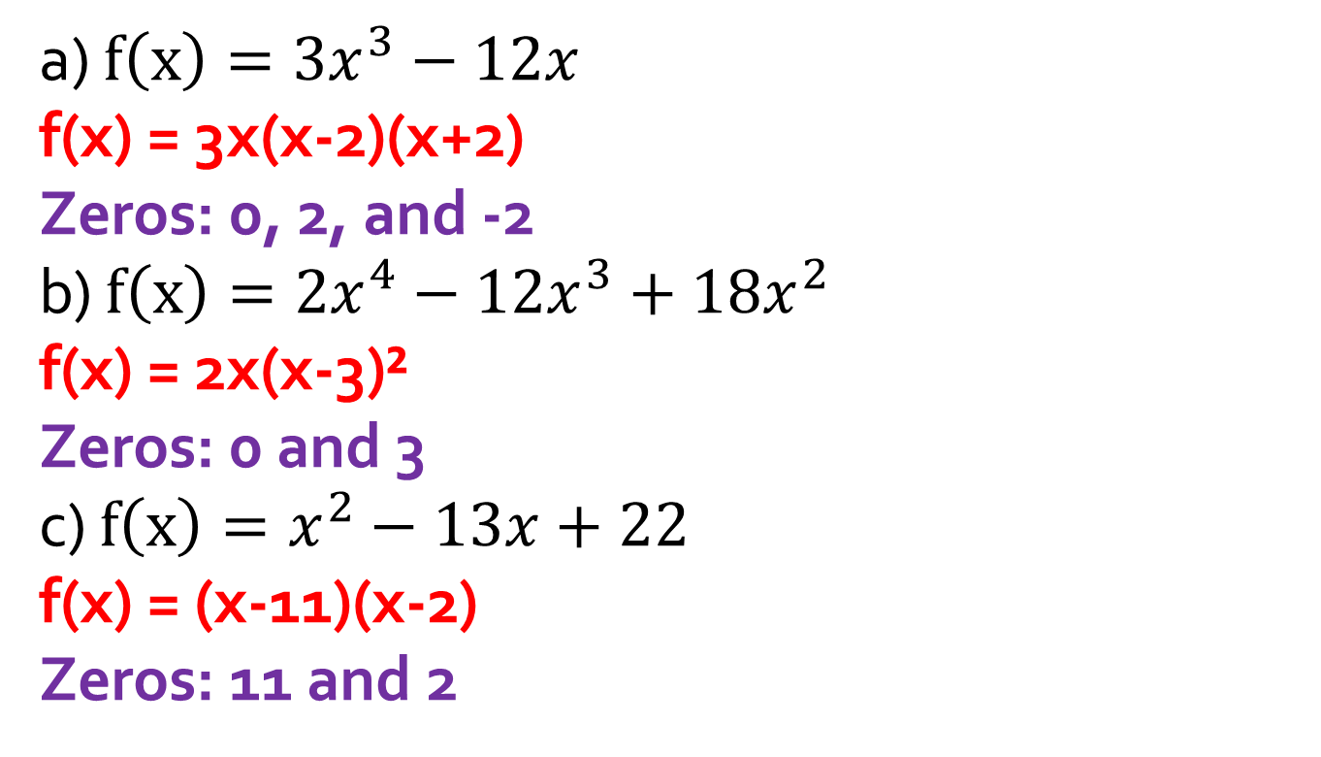
Example 2: Factor each polynomial function and find the zeros.
a) $f\left(x\right)=3x^{3}−12x$
f(x) = 3x(x-2)(x+2)
Zeros: 0, 2, and -2
b) $f\left(x\right)=2x^{4}−12x^{3}+18x^{2}$
f(x) = 2x(x-3)²
Zeros: 0 and 3
c) $f\left(x\right)=x^{2}−13x+22$
f(x) = (x-11)(x-2)
Zeros: 11 and 2

Slide 8
Homework:
Pg 339
Exercises 1, 2, 3 – 21 (mult 3), 33 – 36

Slide 9
More on Complex Roots:
x² + 1 cannot be factored over the real numbers.
This is a prime polynomial with respect to the real numbers.
It is NOT prime with respect to the complex numbers.
This can be rewritten as x² – i².
Factored: (x – i)(x + i)

Slide 10
Multiple roots!
Any n^{th} degree polynomial always has n linear factors (real OR complex).
Each linear factor produces a root.
Repeated linear factors produce multiple roots, or multiple zeros.
Example:
The factored form of $f\left(x\right)= x^{5}−{6x}^{4}+{9x}^{3}$ is
$f\left(x\right)=(x−0)(x−0)(x−0)(x−3)(x−3)$.
Roots: 0 and 3
0 has a multiplicity of three and 3 has multiplicity of two.
The 5th degree polynomial has 5 roots: 3 zeros and 2 threes.

Slide 11
The Factor Theorem:
If f is a polynomial function, (x – a) is a factor if and only if a is a zero of f.
a is a zero of f if x – a divides f exactly.

Slide 12
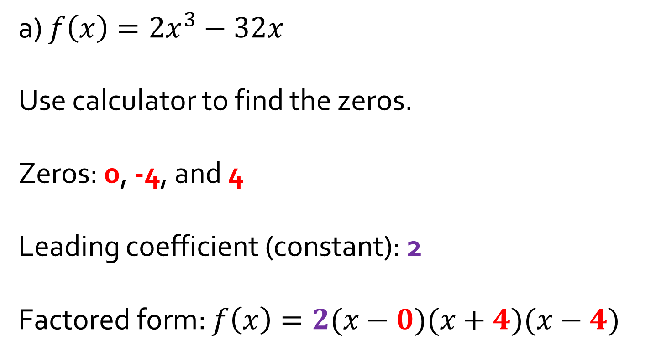
Example 3: Use the Factor Theorem to write each polynomial in factored form.
a) $f\left(x\right)=2x^{3}−32x$
Use calculator to find the zeros.
Zeros: 0, -4, and 4
Leading coefficient (constant): 2
Factored form: $f\left(x\right)=2(x−0)(x+4)(x−4)$

Slide 13
Example 3: Use the Factor Theorem to write each polynomial in factored form.
b) $f\left(x\right)=3x^{4}+12x³+12x²$
Use calculator to find the zeros.
The graph only TOUCHES the x-axis at two zeros.
Zeros: 0, -2
*When the graph TOUCHES the x-axis, the zeros have EVEN
multiplicity.
*When the graph CROSSES the x-axis, the zeros have ODD
multiplicity.
Leading coefficient (constant): 3
Factored form: $f\left(x\right)=3(x−0)²(x+2)²$

Slide 14

Try these: Factor
a) $f\left(x\right)=2x^{3}−18x$
b) $f\left(x\right)={3x}^{5}+{12x}^{4}+{12x}^{3}$

Slide 15
Classwork:
6.2 Exploration

Slide 16
Homework:
6.2 Practice and Apply Worksheet

